Slide 1
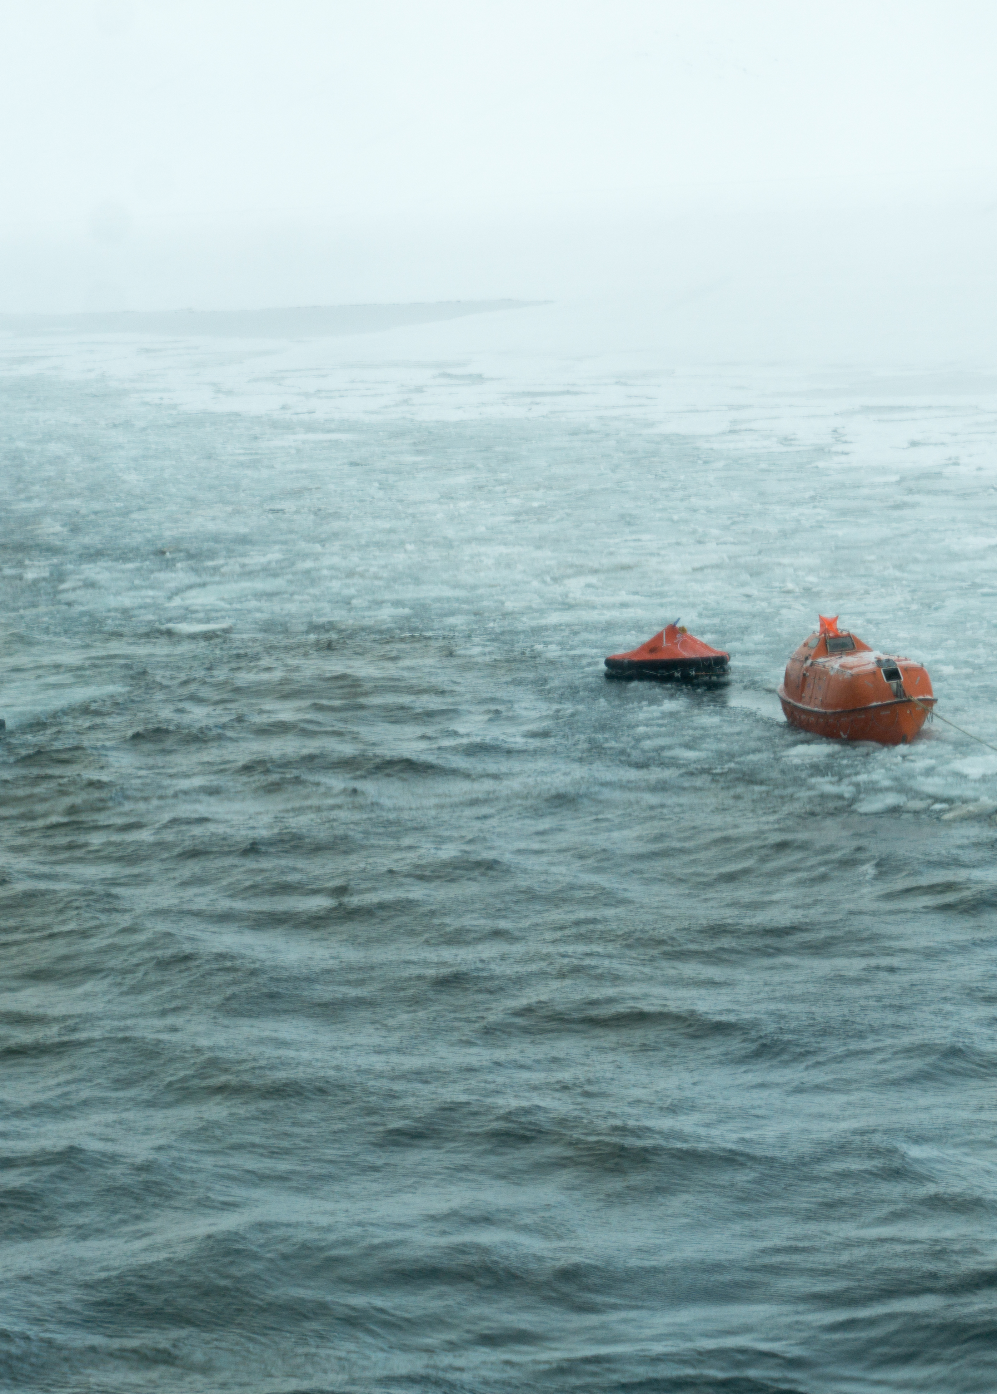



Forskning og utvikling i havrommet
MUF 2016
Bjørn-Morten Batalden, PhD
Førsteamanuensis
Notes:
Mitt hovedbudskap – vi må jobbe sammen – då kan vi få til svære greier.
Story – Troms Offshore – to kapteiner som eg fikk spesielt sansen for – en fra Høgskolen og en fra Fagskolen. De var så like på mange måtar – men de utfylt kvarandre – og de viste det.
Begge fiskarar – kanon resultat på drift, tilfredshet hos mannskap, hos befraktar, fra kontoret - koffor blei det så bra – dei samarbeida godt.
Alle eig maritim drift – siving NTH, sivøk NHH, logistikk molde, Texaco ringen. Brått fins det ingen reglar eller bevis for ka som er bra og dårlig. Ka e bra og dårlig.

Slide 2
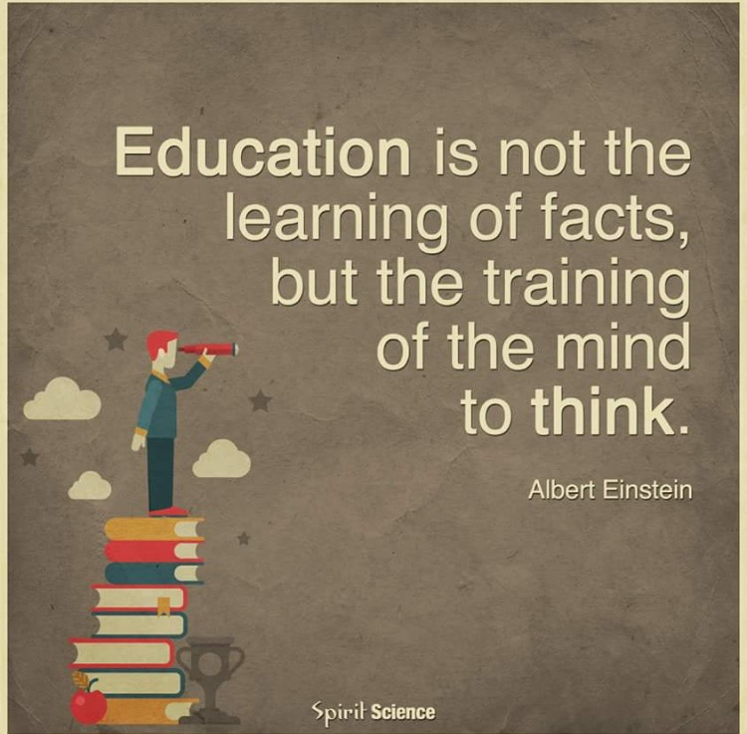
Notes:
Teoretisk kunnskap (eller skole) => anvende i praksis / operasjoner
Nautiske dimensjoner – operasjon (nav, last, sjøv,), ledelse, økonomi, drift, vedlikehold, logistikk etc.
Som nautiker bør kandidaten bidra i nautiske debatter og være kritisk til teorier og praksis, så vel som forslag til endringer.
Uni kan miste sitt formål om kandidatene ikke besitter evne til kritisk tenkning og evne til å finne nye løsninger.
Meir enn tilpassning til eksisterende kunnskap og praksis.

Slide 3
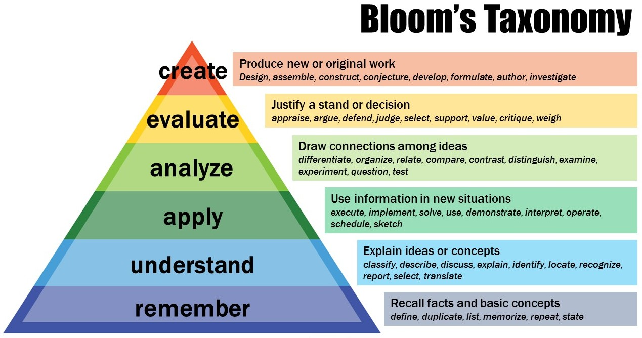
Notes:
En må teste gjeldende kunnskap og praksis, og om mulig identifisere det gode, finne feil, unøyaktigheter og svakheter. Gjennom aktiv deltakelse og interaksjon med andre vil en kunne bringe profesjonen videre.
Tenke med teori og etablert praksis, tenke mot teori og etablert praksis og tenke selv.

Slide 4
Forskning
Problemanalyse
Hva er faktisk problemet?
Hvorfor er det et problem?
Hvem sitt problem er det?
Design
Intervensjonsplan for å finne løsning.
Endring
Gjennomføre design/plan.
Evaluere
Verifisere i hvilken grad endringer har løst problemet.
Notes:
Grunnforskning – hukommelse og læring, spatial evner.

Slide 5
A key finding of the MAIB investigation is that no departure stability calculation had been carried out on completion of cargo operations and before Hoegh Osaka sailed.
Witness and anecdotal evidence suggests that this practice extends to the car carrier sector in general.

Slide 6
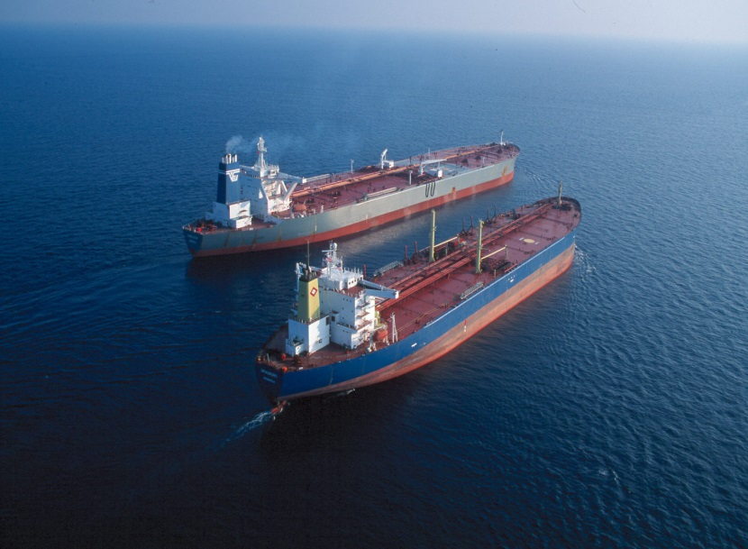
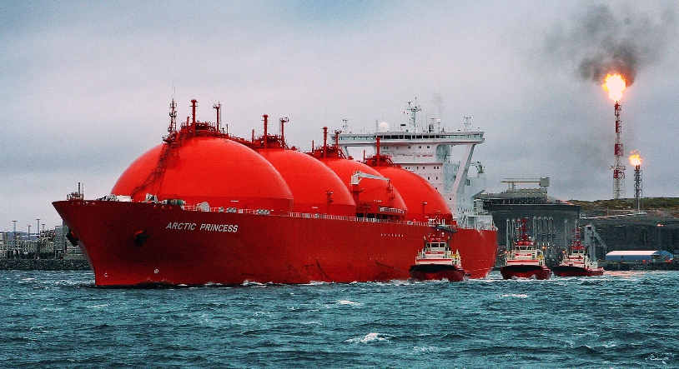
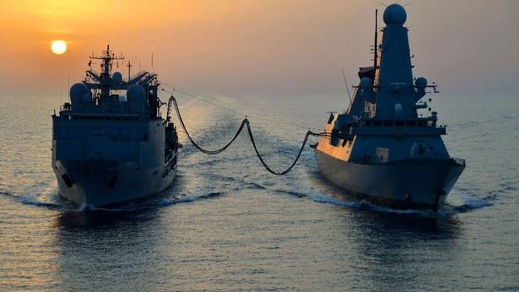
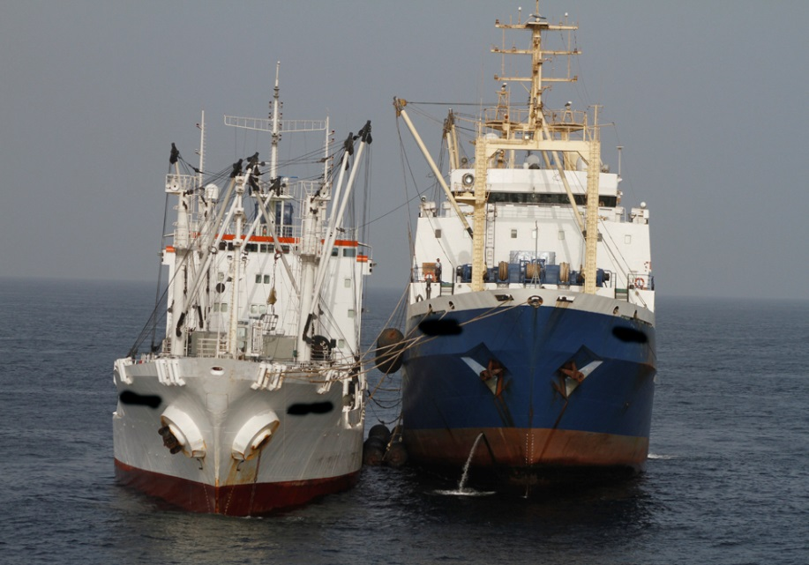
Ship-to-Ship (STS) Operations
Lightering Operations
Ship-Tug Operations
PST Ltd.
www.maritimejournal.com
Syria operation: HMS Diamond gets Replenishment at sea from the French Ship
Var Credit: FS Var
Replenishment-at-sea Operations
http://voices.nationalgeographic.com
Fish transfer Operations
Notes:
Ship-To-Ship (STS) operations, such as lightering operations, ship-tug operations, replenishment-at-sea are carried out and controlled by human operators.
About 25 percent of all oil imported to the USA comes currently through lightering operations, and it is assumed that the need for ship-to-ship transfer will increase for transport of oil and gas products to customers in Europe and USA.
And in this study, we focused on the lightering operation (300k DWT VLCC as the STBL, 100k DWT Aframax as the SS) where two ships are together in open waters and transfer the cargo, like crude oil, LNG, etc.

Slide 7
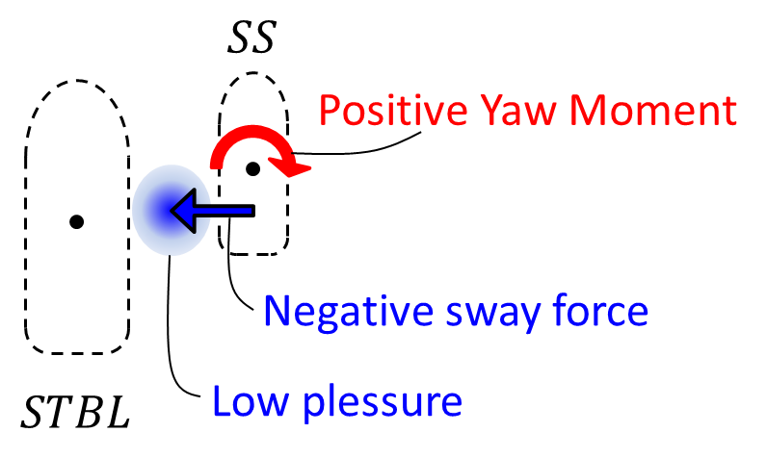
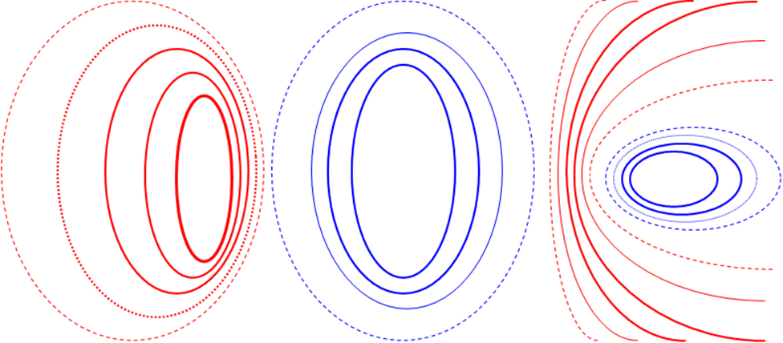

Hydrodynamic Interaction Effects
Illustration of an unwanted yaw moment.
Boundary
Zone
Boundary
Zone
Complex Low
Pressure
Experienced Sea Pilot’s view of the forces acting on his vessel.
A
AA
Highest
Pressure
Low
Pressure
High
Pressure
Surface Pressure Field patterns
P. J. McARTHUR, Norwest Interaction Ltd, UK.

Slide 8
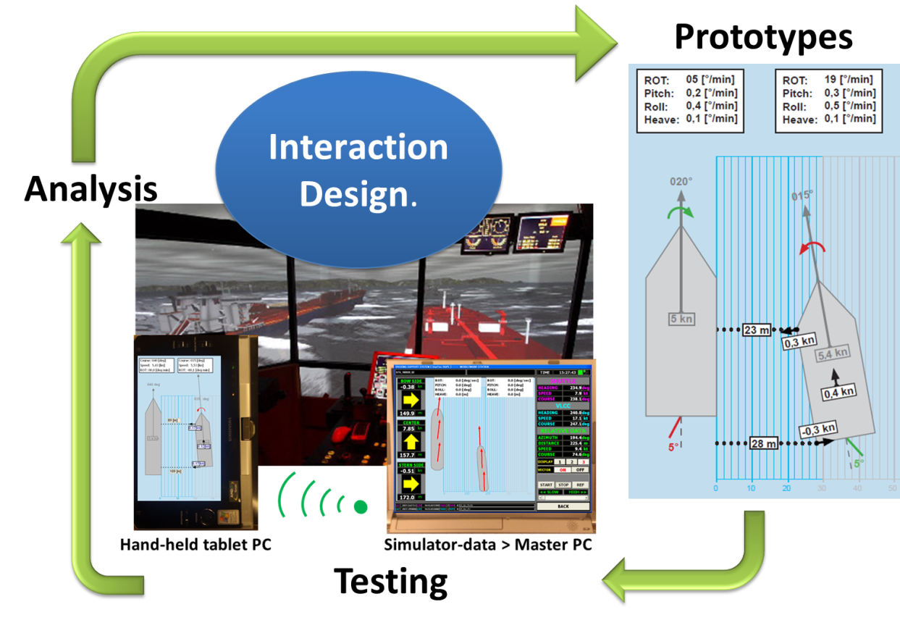
Development of the Graphical User Interface (GUI)

Slide 9
Safety management in shipping
Main research theme: How safety management functions in the enforced self-regulatory regime established by the ISM Code.
To some extent a lack of external pressure
Possibility for capture
Limited use of expertise
A main challenge to safety management in the shipping industry concerns the element of planning and organization of work

Slide 10
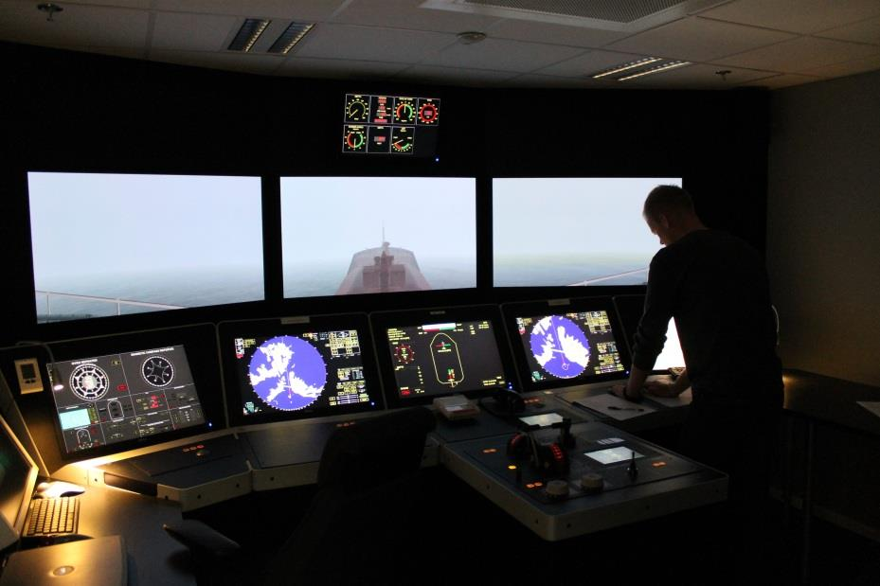
Kvifor seilar ein north-up?
Notes:
Spasial orintering – kapasitet – endrer det seg ift om en har Nup og Hup?
Spatial evne, et individs evne til å kunne skape et mentalt bilde, en forestilling, om romlige forhold, samt det å kunne operere med romlige relasjoner.
-former og avstander, drive med orientering eller orientere seg i en by.

Slide 11
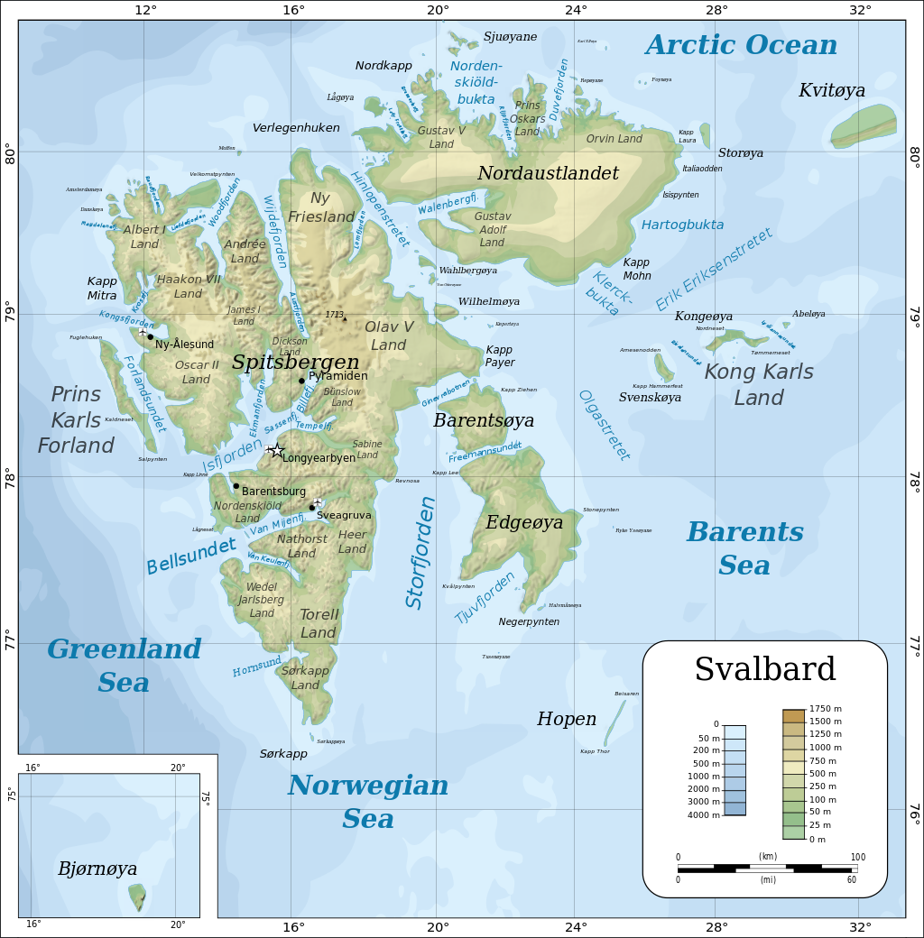
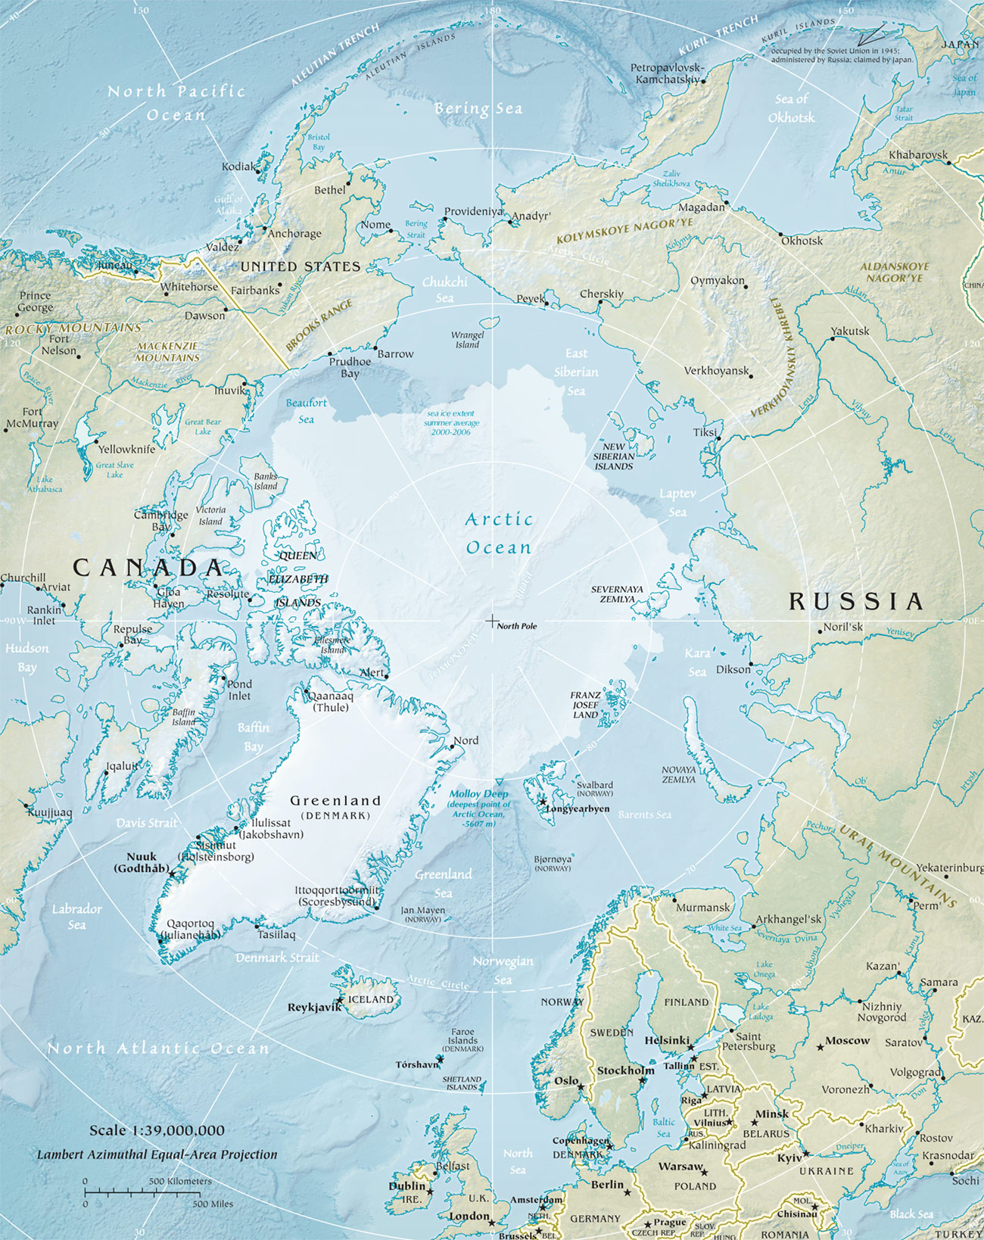
SARex was conducted north of Spitzbergen in ice influenced water in late April 2016
Notes:
The exercise scenario is to be along the lines of a “Maxim Gorkiy scenario” July 1989 where an expedition cruise ship sinks in the marginal ice zone north of the coast of Svalbard.
Dep Longyear 22/4 – Phase I started morning 24/4
2014 22 skip og 35000 pax. Ocean cruise vessels
Expedition cruises 12 – 400 pax – the largest activity – June-September

Slide 12
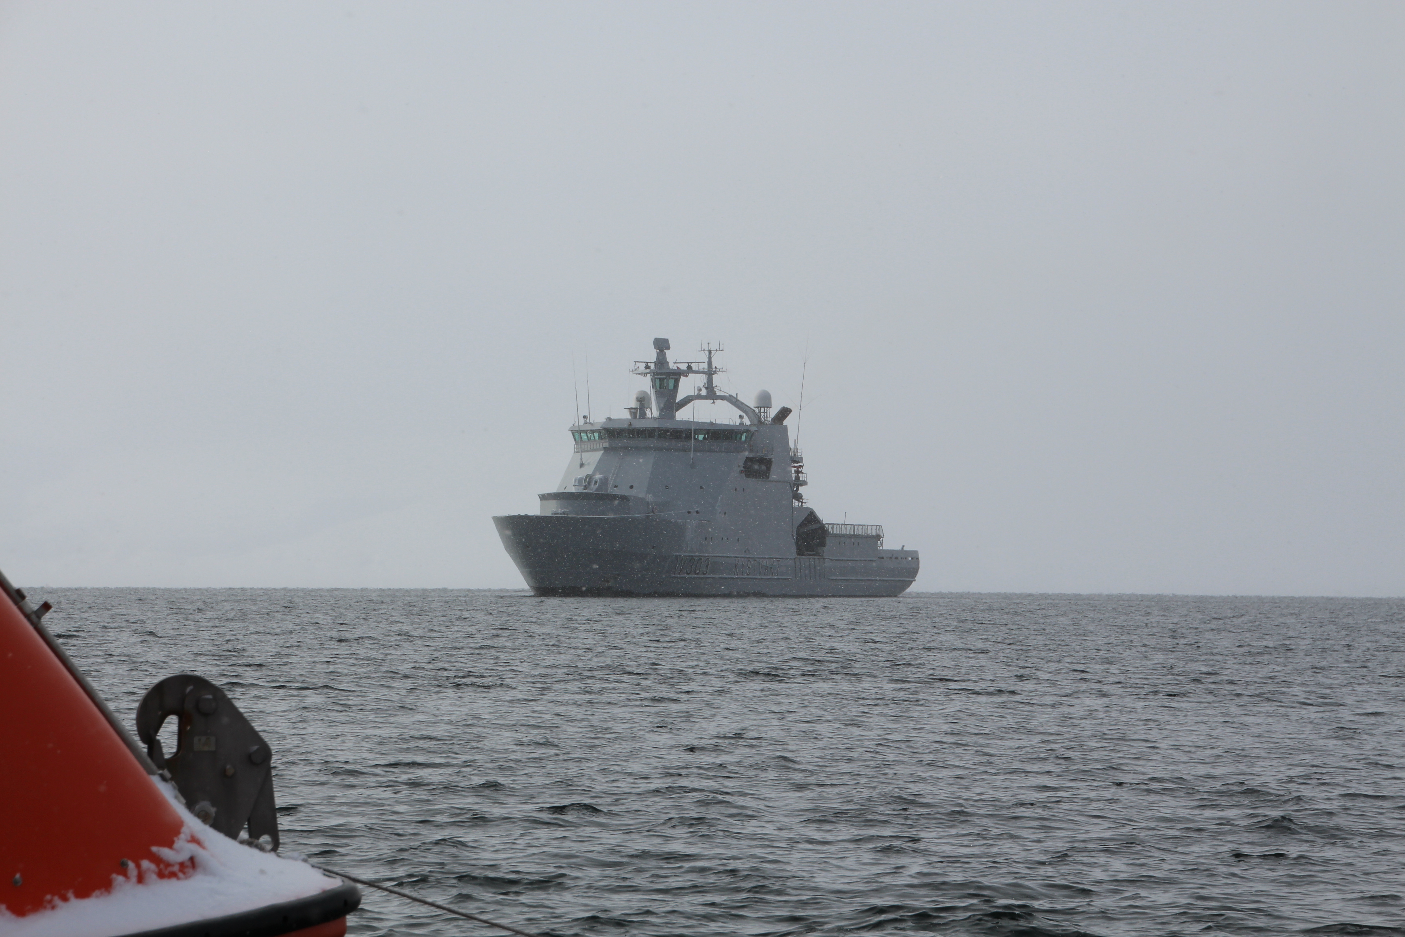
Identify and explore the gaps between the functionality provided by the existing SOLAS approved safety equipment and the functionality required by the Polar Code
Survival time of 5 days
Hypotermi:
the start of the end
Cognitive abilities
Body control
Fine motor skills –
extremities
Notes:
The exercise scenario is to be along the lines of a “Maxim Gorkiy scenario” July 1989 where an expedition cruise ship sinks in the marginal ice zone north of the coast of Svalbard.
2014 22 skip og 35000 pax. Ocean cruise vessels
Expedition cruises 12 – 400 pax – the largest activity – June-September

Slide 13
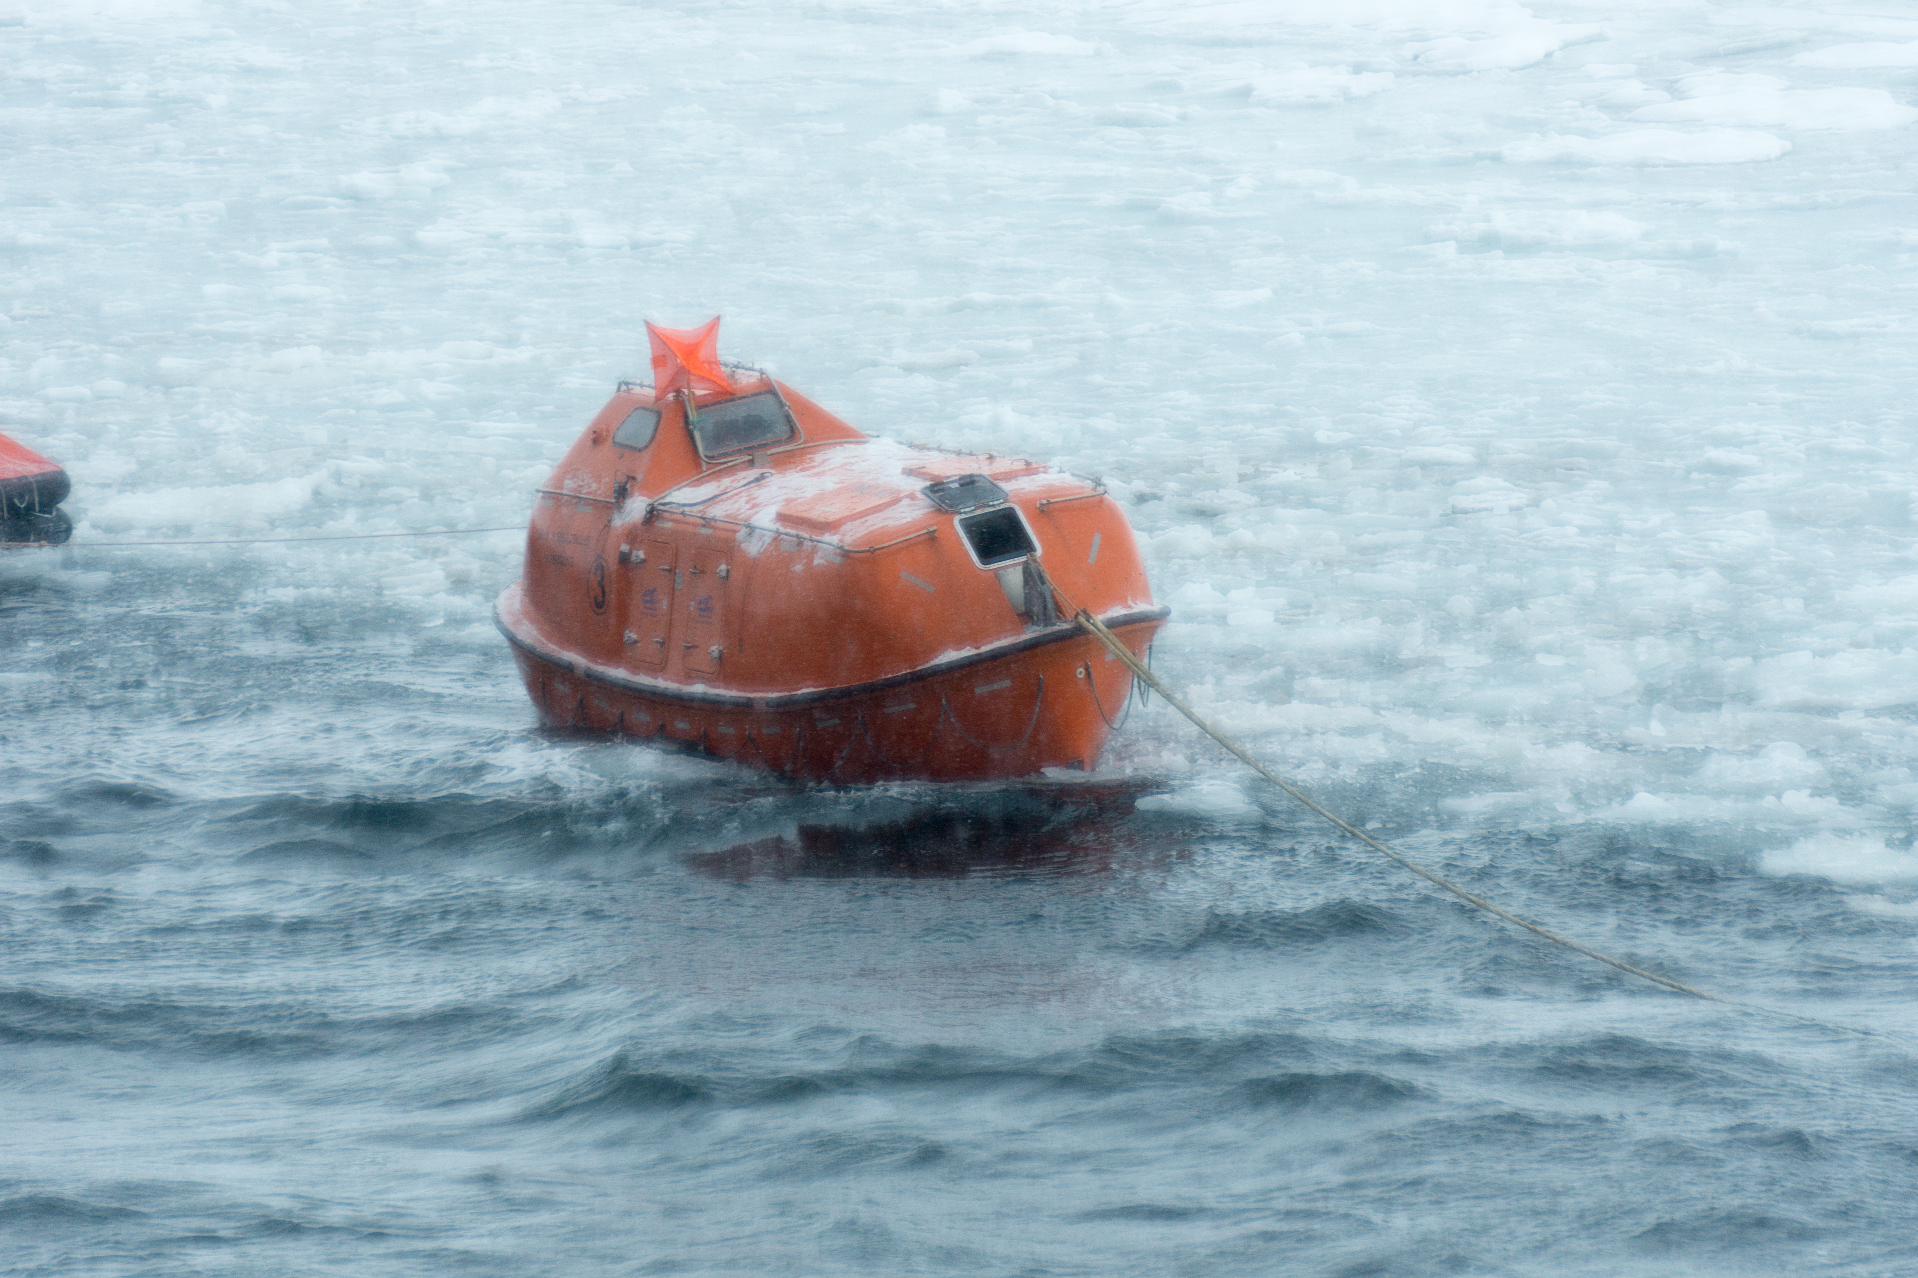
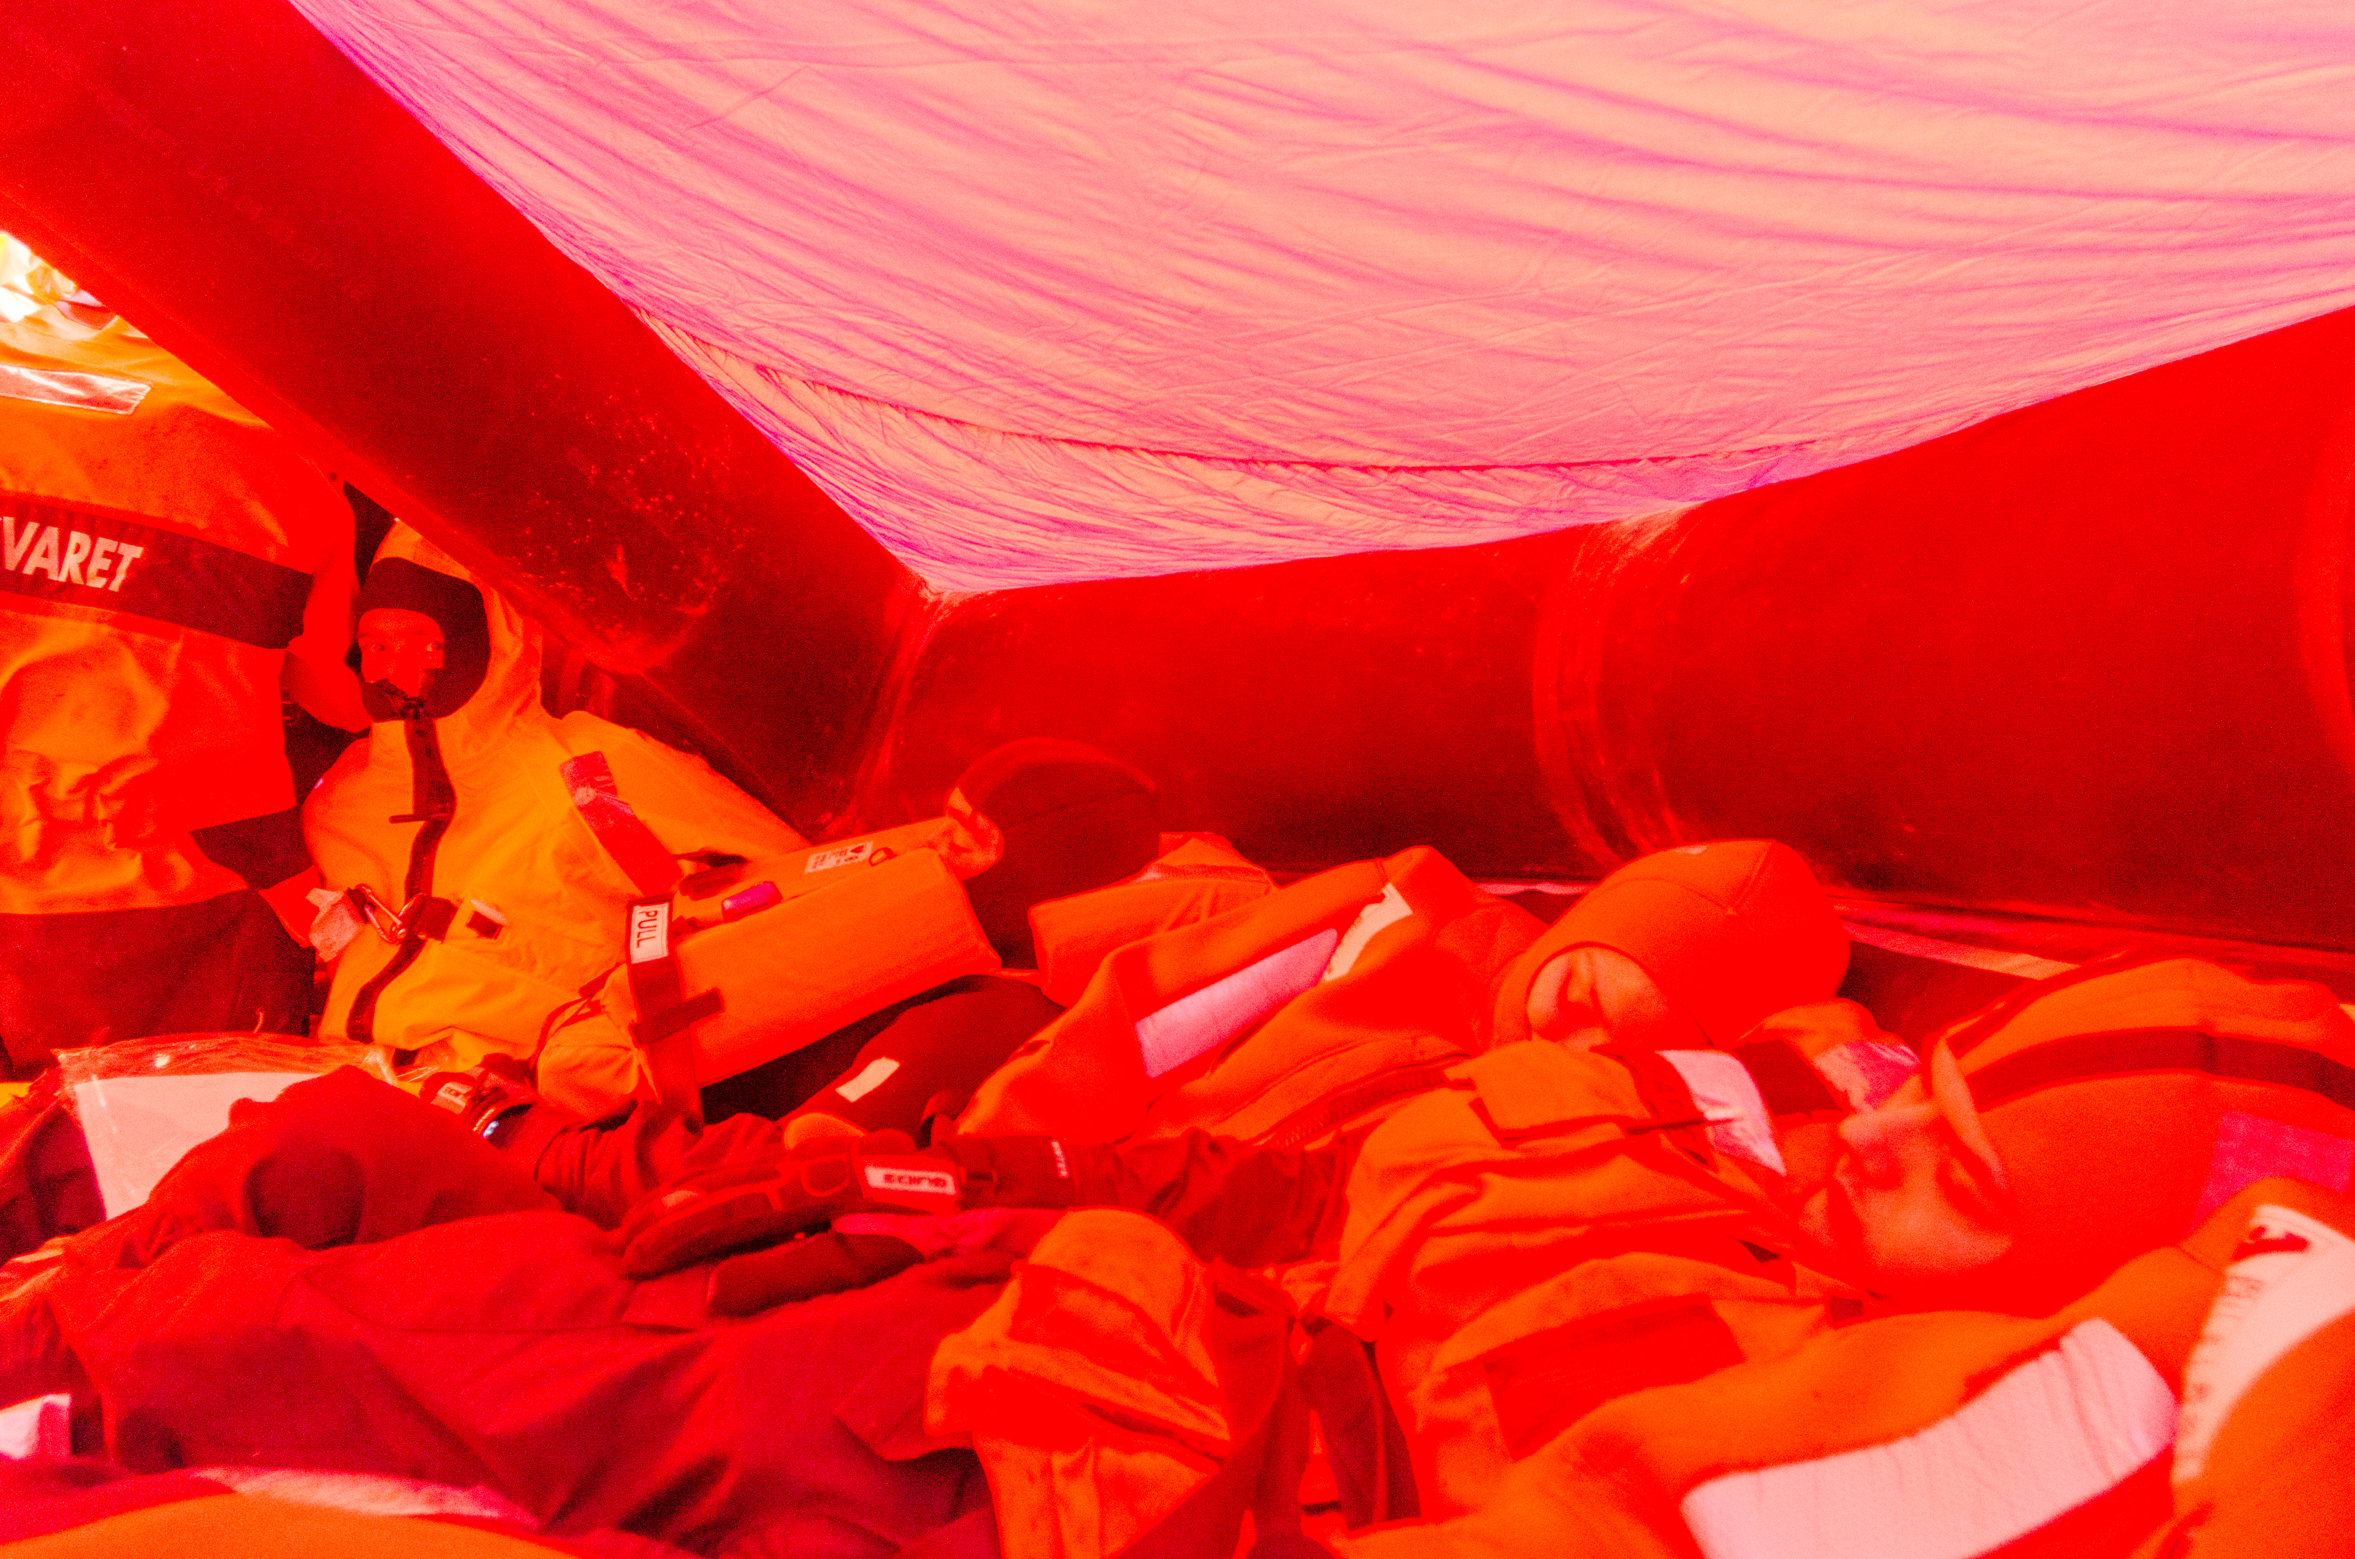
Notes:
6 person still onboard when the exercise stopped
Mod
- heat generating devices in place in the lifeboat, there is moisture removal measures installed, the need for thermal protection is NOT present.
- neoprene foam on the seats and other hard and cold object should be standard
- Cockpit windows need special attention for deicing or extra heating to prevent ice buildup

Slide 14
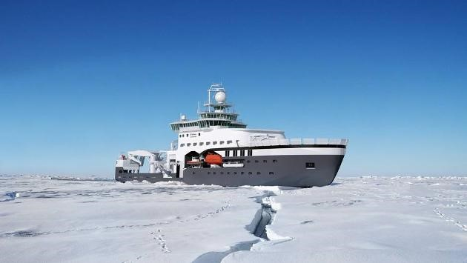
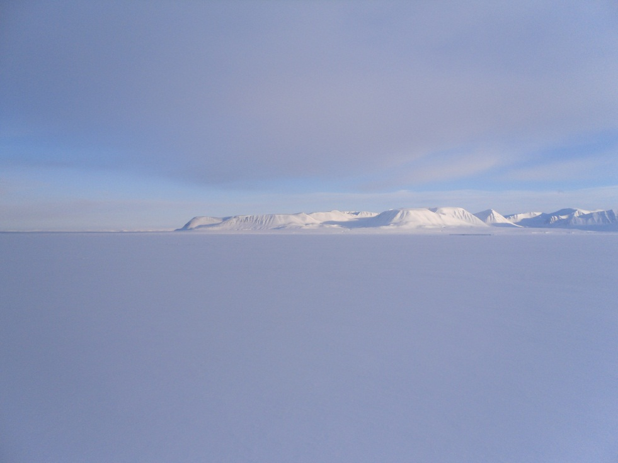
On – land command center (OLCC)
Access to “all” on-board sensor data
from the research ship
“Kronprins Haakon” 2017/2018
“Decision systems”
provide support in
complex tasks
analyzing
“Black box”

Slide 15
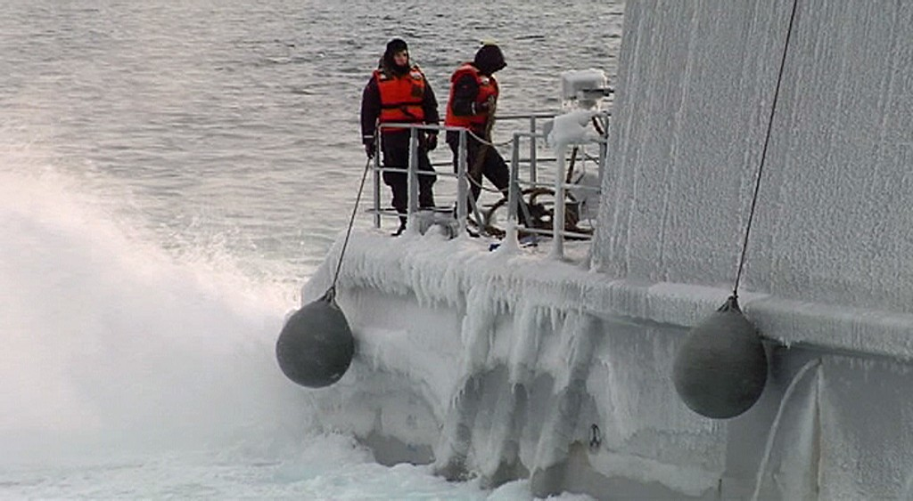


Prediction of icing on ships - modelling and results
Eirik Mikal Samuelsen^{1,2}
1 UiT - The Arctic University of Norway 2 Norwegian Meteorological Institute
03 November 2016
Photo: Nils Mehren, NRK

Slide 16
Possible next publication
Icing/no icing observations from several ships 1980-2006 Correlation with T_{a} , H_{s} , V and snow showers
Find correlation with upper-air renalysis data (T₈₅₀, Z₅₀₀)?

Slide 17
Understanding the Eye of the Navigator
Hareide et al. ‎2016
How we better can use maritime navigation simulators?
How to develop bridge design and general user interface to ease
the burden of the navigator?
Notes:
Comparative study of the Skjold-class bridge- and simulator navigation training
Intro – grunnstøtinger – hva skjer?
PPL scan mønster
Eye tracker kan benyttas for å utvikle grafisk brukergrensesnitt og navigasjonspraksis – i trening/utdanning og evaluering?
GUI route monitor – tidskrevende å hente info
Identifisere visuelle tyver – rødt.

Slide 18

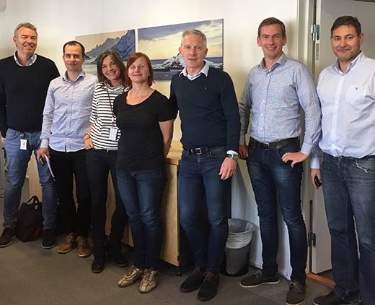
ARCEVAC
Improving Passenger Safety and Survivability in the Extreme Conditions associated with ARCtic and Antarctic EVACuation
The objectives:
evaluate passenger ship evacuation
provide, better evacuation options, improved passenger survivability, and
enhanced resilience in the extreme environment of Polar waters.
Main researchers:
• Helle Oltedal, Project Manager
• Professor Ed Galea

Slide 19
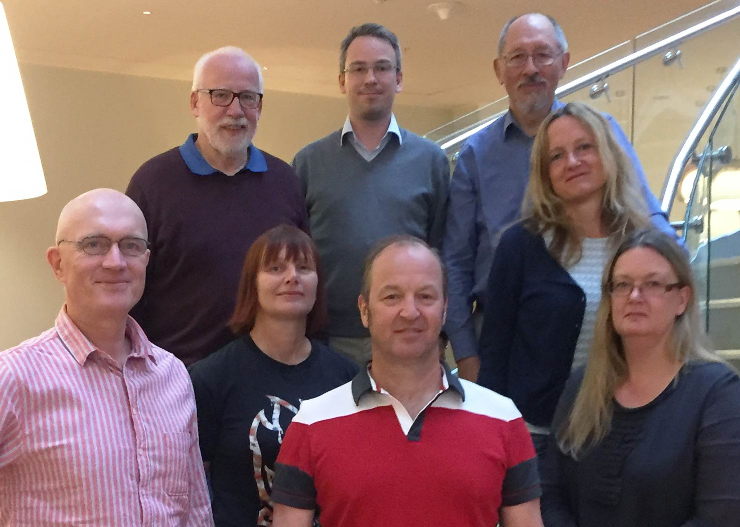
Managing Maritime Safety
- a book project for higher level students
A collaborative project to develop a syllabus covering safety theories, safety management within the maritime domain.

Slide 20
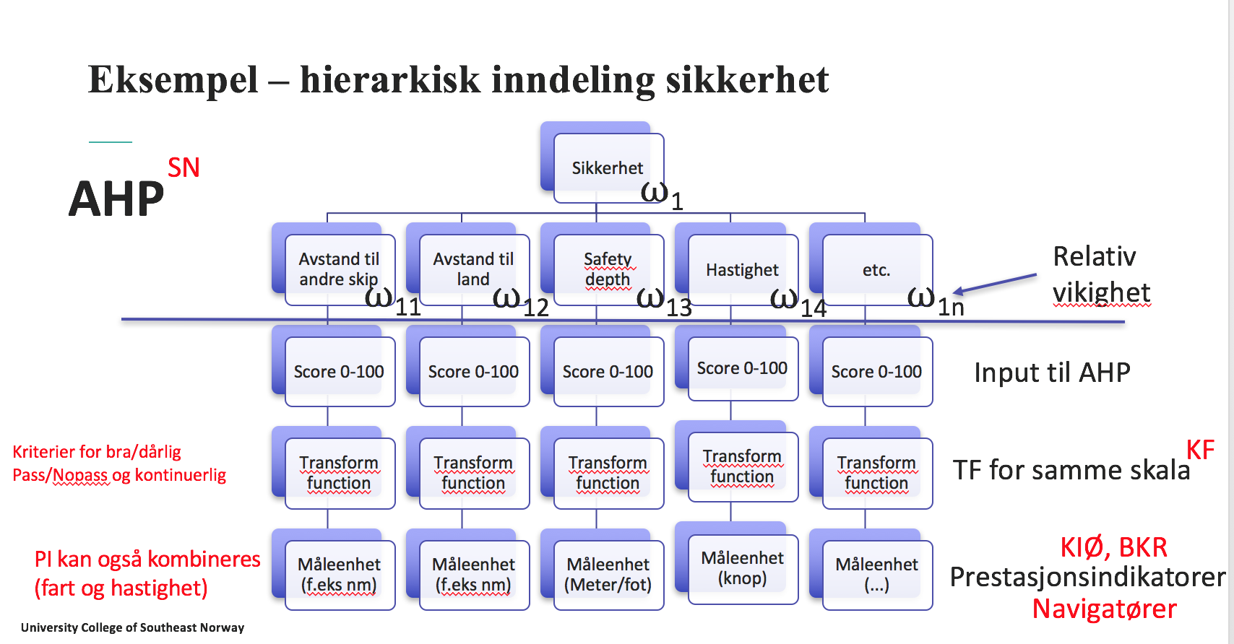
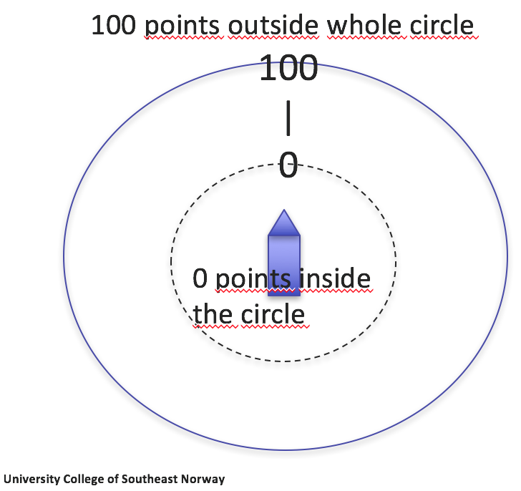
Kjell Ivar Øvergård, HSN
GruNT-Project: (Oslofjordfondet 420k NOK)
Partners: Kongsberg Maritime, DNV-GL, HSN.
What: Create a quantiative multidimensional model of control requirements for coastal navigation and docking
Why: make automated assessments of navigational performance during simulator training
How: Identify accepted values for parameters such as ’distance to vessels’, ’distance to land’, ’depth under the keel’, and so on and weigth and aggregate across a a number of parameters.
Validity: Will be tested against evaluations of subject matter experts.
Other future uses: Can be used for route planning, assessment of real-time navigation, and for predictive risk-based decision-support.

Slide 21
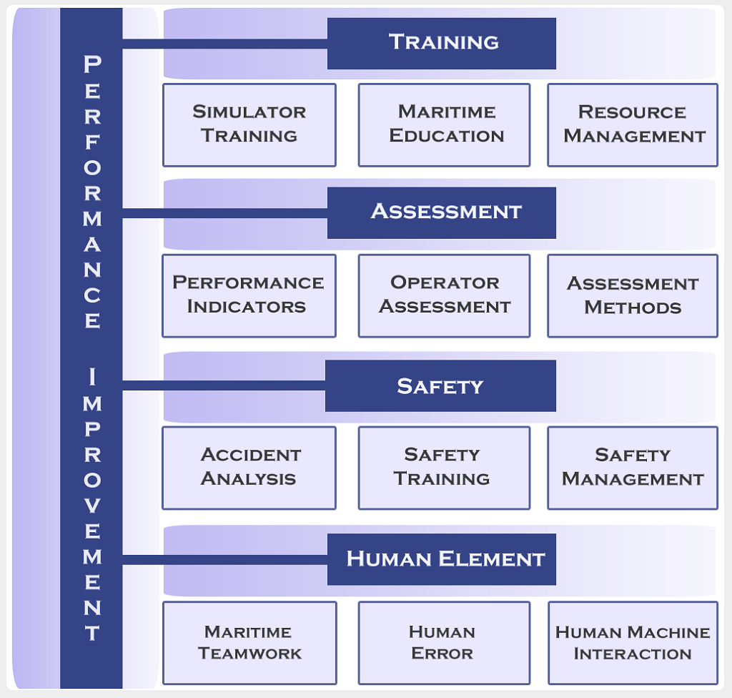
Training and Assessment Research Group
(TARG)
Forsker på interaksjonen mellom menneske og maskin når en får stadig mer komplekse system og operasjoner.
http://targlab.com/
Notes:
Exploring marine accident causation: A case study. T., Kim, S. Nazir
The role of situation awareness in accidents of large-scale technological systems, Mohsen Naderpour, S. Nazir, Jie Lu
Impact of Training Methods on Distributed Situation Awareness of Industrial Operators, Nazir, L. J. Sørensen, K. I.Øvergård, D. Manca

Slide 22
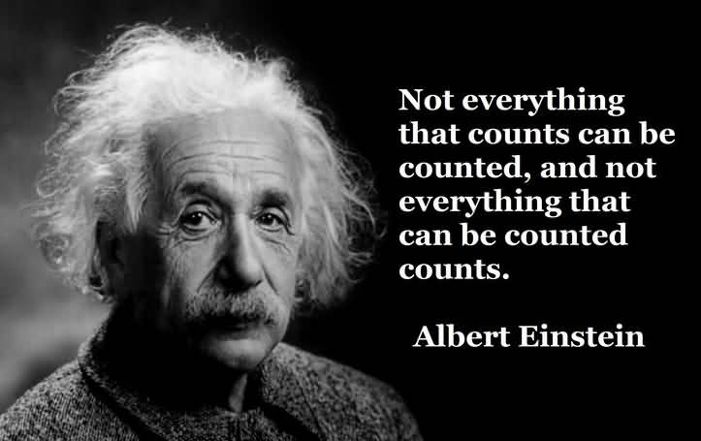
Notes:
Ikkje alt som teller kan tellast, og ikkje alt som kan tellast teller.

